Slide 1
Lecture 2 – More on R, descriptive measures, visualizing data
OPIM 5603 – Statistics in Business Analytics

Slide 2
Outline
Descriptive measures
Organizing categorical data
Descriptive measure summaries
Visualization
R
Packages
Loading data from your computer
Creating sequences and repetitions
Central Tendencies and distribution measures
Plotting and Tables
Data Types
Data Frames
Lists

Slide 3
Descriptive Measures
The central tendency is the extent to which the values of a numerical variable group around a typical or central value.
Mean, Median, Mode, Geometric Mean
The variation is the amount of dispersion or scattering away from a central value that the values of a numerical variable show.
Range, Variance, Standard Deviation
The shape is the pattern of the distribution of values from the lowest value to the highest value.
Skewness, Kurtosis

Slide 4
Mean (Arithmetic Mean)
Most common measure of central tendency
Can be affected by outliers
The i^{th} value
Pronounced x-bar
Sample size
Observed values

Slide 5
Mean
Although it measures central tendency, it doesn’t tell the whole story
Outliers can have significant impact on this measure
11 12 13 14 15 16 17 18 19 20
11 12 13 14 15 16 17 18 19 20
Mean = 13
Mean = 14

Slide 6
Median
In an ordered array, the median is the middle number (50% above, 50% below).
If there is an even number of observations, typically taken as the mean of the two central values
Less sensitive to outliers
11 12 13 14 15 16 17 18 19 20
11 12 13 14 15 16 17 18 19 20
Median = 13
Median = 13

Slide 7
Median
The location of the median when the values are in numerical order (smallest to largest):
If the number of values is odd, the median is the middle number
If the number of values is even, the median is the average of the two middle numbers
Note that it isn’t the value (n+1)/2, but the value that is sitting in the (n+1)/2th position

Slide 8
Mode
Value that occurs most often
Not affected by extreme values
Used for either numerical or categorical data
There may be no mode
There may be several modes
0 1 2 3 4 5 6 7 8 9 10 11 12 13 14
0 1 2 3 4 5 6
Mode = 9
No Mode

Slide 9
Geometric Mean
Uses the product of values as opposed to the sum of values
Useful in the following situations:
To measure the rate of change of a variable over time
Population growth
Comparing items on a different scale
Ex: Suppose that an investment earns 10% in year 1, 35% in year 2, and 6% in year 3
Would you say that the mean rate of return is 17%? (the arithmetic mean)
Would you say that the mean rate of return is 16.3%? (the geometric mean)
This is actually the Geometric Mean Rate of Return

Slide 10
Descriptive Measures
The central tendency is the extent to which the values of a numerical variable group around a typical or central value.
Mean, Median, Mode, Geometric Mean
The variation is the amount of dispersion or scattering away from a central value that the values of a numerical variable show.
Range, Variance, Standard Deviation
The shape is the pattern of the distribution of values from the lowest value to the highest value.
Skewness, Kurtosis

Slide 11
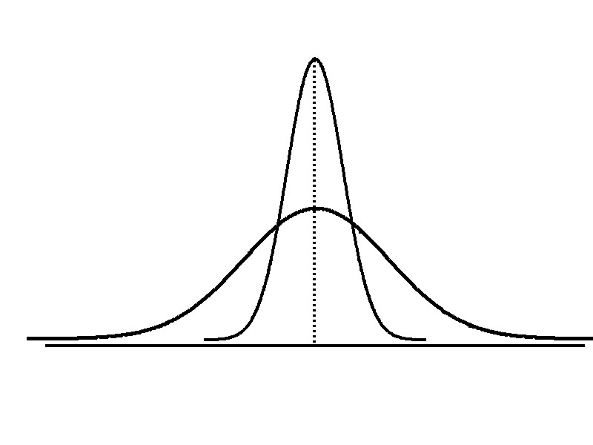
Variation
Measures of variation give information on the spread or variability or dispersion of the data values
Variation
Range
Variance
Standard Deviation
Coefficient of Variation
Same center,
different variation

Slide 12
Range
Difference between the largest and the smallest values:
Simplest measure of variation, but already gives some information
Very sensitive to outliers
Range = X_{largest} – X_{smallest}
Example:
0 1 2 3 4 5 6 7 8 9 10 11 12 13 14
Range = 13 - 1 = 12

Slide 13
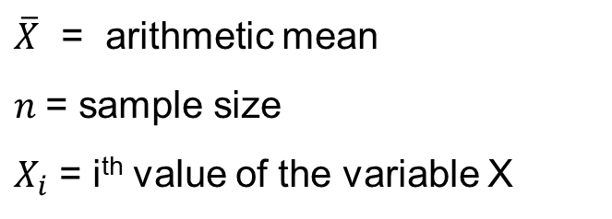
Variance
Average (approximately) of squared deviations of values from the mean
Sample variance:
Why do you think we square the terms?
Where
$\overline{X}$ = arithmetic mean
$n$= sample size
$X_{i}$ = i^{th} value of the variable X

Slide 14
Standard Deviation
Is the square root of the variance
Sample standard deviation
Has the same units as the data
Most commonly used measure of dispersion

Slide 15
Calculating Standard Deviation
Compute the difference between each value and the mean.
Square each difference.
Add the squared differences.
Divide this total by n-1 to get the sample variance.
Take the square root of the sample variance to get the sample standard deviation.
Sample Data (X_{i}) : 10 12 14 15 17 18 18 24
n = 8 Mean = X = 16

Slide 16
Characteristics of Standard Deviation
The more the data are spread out, the greater the range, variance, and standard deviation.
The more the data are concentrated, the smaller the range, variance, and standard deviation.
If the values are all the same (no variation), all these measures will be zero.
None of these measures are ever negative.
Smaller standard deviation
Larger standard deviation

Slide 17
Descriptive Measures
The central tendency is the extent to which the values of a numerical variable group around a typical or central value.
Mean, Median, Mode, Geometric Mean
The variation is the amount of dispersion or scattering away from a central value that the values of a numerical variable show.
Range, Variance, Standard Deviation
The shape is the pattern of the distribution of values from the lowest value to the highest value.
Skewness, Kurtosis

Slide 18
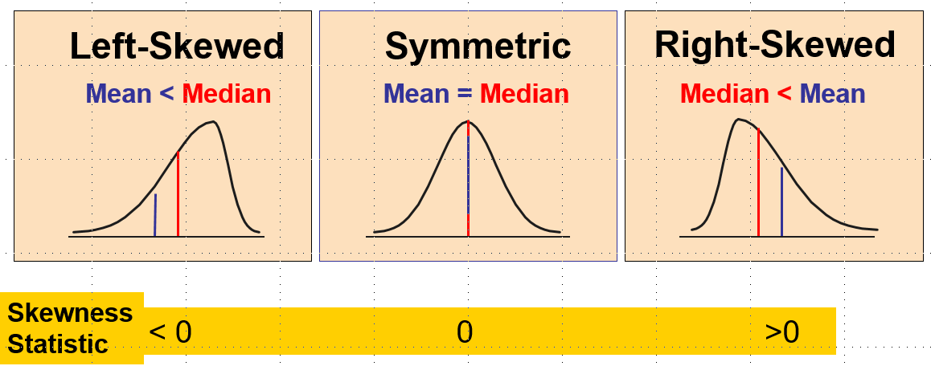
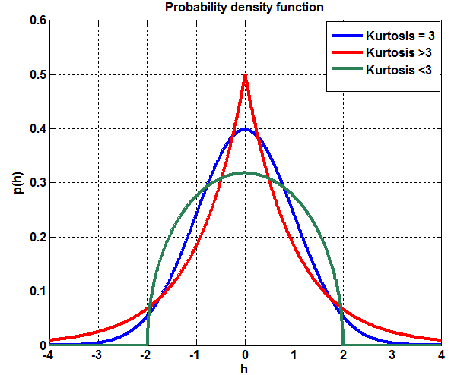
Shape of a Distribution
Describes how data is distributed
Two useful shape related statistics are:
Skewness:
Measures the extent to which data values are not symmetrical
Kurtosis:
Kurtosis measures the peakedness of the curve of the distribution

Slide 19
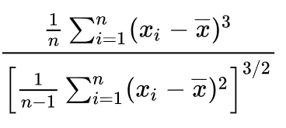
Skewness formula

Slide 20
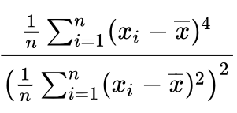
Kurtosis Formula
Note about Kurtosis:
A normal curve has kurtosis exactly equal to 3 - mesokurtic
A kurtosis less than 3 (negative excess) indicates that the distribution has fewer outliers, so that its tail would be flatter - playtkurtic
A kurtosis more than 3 (positive excess) is the opposite situation - leptokurtic

Slide 21
Frequency Tables
A summary table tallies the frequencies or percentages of items in a set of categories so that you can see differences between categories
Summary Table From A Survey of 1000 Banking Customers
Banking Preference? | Percent
ATM | 16%
Automated or live telephone | 2%
Drive-through service at branch | 17%
In person at branch | 41%
Internet | 24%

Slide 22
Contingency Tables
Contingency Table Showing
Frequency of Invoices Categorized
By Size and The Presence Of Errors
Helps organize two or more categorical variables
Used to study patterns that may exist between the responses of two or more categorical variables
Cross tabulates or tallies jointly the responses of the categorical variables
For two variables the tallies for one variable are located in the rows and the tallies for the second variable are located in the columns
A random sample of 400 invoices is drawn.
Each invoice is categorized as a small, medium, or large amount.
Each invoice is also examined to identify if there are any errors.
This data are then organized in the contingency table to the right.
 | No Errors | Errors | Total
Small Amount | 170 | 20 | 190
Medium Amount | 100 | 40 | 140
Large Amount | 65 | 5 | 70
Total | 335 | 65 | 400

Slide 23
Contingency Table Based On Percentage Of Overall Total
 | No Errors | Errors | Total
Small Amount | 170 | 20 | 190
Medium Amount | 100 | 40 | 140
Large Amount | 65 | 5 | 70
Total | 335 | 65 | 400
42.50% = 170 / 400
25.00% = 100 / 400
16.25% = 65 / 400
 | No Errors | Errors | Total
Small Amount | 42.50% | 5.00% | 47.50%
Medium Amount | 25.00% | 10.00% | 35.00%
Large Amount | 16.25% | 1.25% | 17.50%
Total | 83.75% | 16.25% | 100.0%
83.75% of sampled invoices have no errors and 47.50% of sampled invoices are for small amounts.

Slide 24
Contingency Table Based On Percentage of Row Totals
 | No Errors | Errors | Total
Small Amount | 170 | 20 | 190
Medium Amount | 100 | 40 | 140
Large Amount | 65 | 5 | 70
Total | 335 | 65 | 400
89.47% = 170 / 190
71.43% = 100 / 140
92.86% = 65 / 70
 | No Errors | Errors | Total
Small Amount | 89.47% | 10.53% | 100.0%
Medium Amount | 71.43% | 28.57% | 100.0%
Large Amount | 92.86% | 7.14% | 100.0%
Total | 83.75% | 16.25% | 100.0%
Medium invoices have a larger chance (28.57%) of having errors than small (10.53%) or large (7.14%) invoices.

Slide 25
Contingency Table Based On Percentage Of Column Totals
 | No Errors | Errors | Total
Small Amount | 170 | 20 | 190
Medium Amount | 100 | 40 | 140
Large Amount | 65 | 5 | 70
Total | 335 | 65 | 400
50.75% = 170 / 335
30.77% = 20 / 65
 | No Errors | Errors | Total
Small Amount | 50.75% | 30.77% | 47.50%
Medium Amount | 29.85% | 61.54% | 35.00%
Large Amount | 19.40% | 7.69% | 17.50%
Total | 100.0% | 100.0% | 100.0%
There is a 61.54% chance that invoices with errors are of medium size.

Slide 26
Quartiles
Quartiles split the ranked data into 4 segments with an equal number of values per segment.
The first quartile, Q1, is the value for which 25% of the observations are smaller and 75% are larger
Q2 is the same as the median (50% of the observations are smaller and 50% are larger)
Only 25% of the observations are greater than the third quartile
Find a quartile by determining the value in the appropriate position in the ranked data, where
First quartile position: Q1 = (n+1)/4 ranked value
Second quartile position: Q2 = (n+1)/2 ranked value
Third quartile position: Q3 = 3(n+1)/4 ranked value
When calculating the ranked position use the following rules
If the result is a whole number then it is the ranked position to us
If the result is a fractional half (e.g. 2.5, 7.5, 8.5, etc.) then average the two corresponding data values.
If the result is not a whole number or a fractional half then round the result to the nearest integer to find the ranked position.
25%
25%
25%
25%
Q1
Q2
Q3

Slide 27
Interquartile Range and an Example
The IQR is Q3 – Q1 and measures the spread in the middle 50% of the data
The IQR is also called the midspread because it covers the middle 50% of the data
The IQR is a measure of variability that is not influenced by outliers or extreme values
Measures like Q1, Q3, and IQR that are not influenced by outliers are called resistant measures
Q1 is in the (9+1)/4 = 2.5 position of the ranked data
Q1 = (12+13)/2 = 12.5
Q2 is in the (9+1)/2 = 5th position of the ranked data
Q2 = median = 16
Q3 is in the 3(9+1)/4 = 7.5 position of the ranked data
Q3 = (18+21)/2 = 19.5
Sample Data in Ordered Array: 11 12 13 16 16 17 18 21 22

Slide 28
5 Number Summary and Box Plots
The five numbers that help describe the center, spread and shape of data are:
Xsmallest
First Quartile (Q1)
Median (Q2)
Third Quartile (Q3)
Xlargest
The Boxplot: A Graphical display of the data based on the five-number summary:
X_{smallest} -- Q₁ -- Median -- Q₃ -- X_{largest}
Example:
25% of data 25% 25% 25% of data
of data of data
X_{smallest} Q₁ Median Q₃ X_{largest}

Slide 29
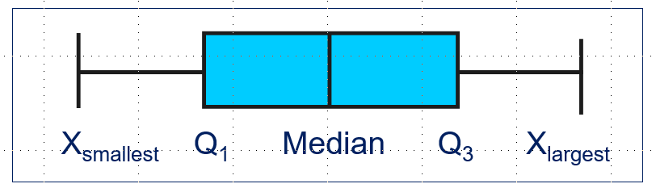
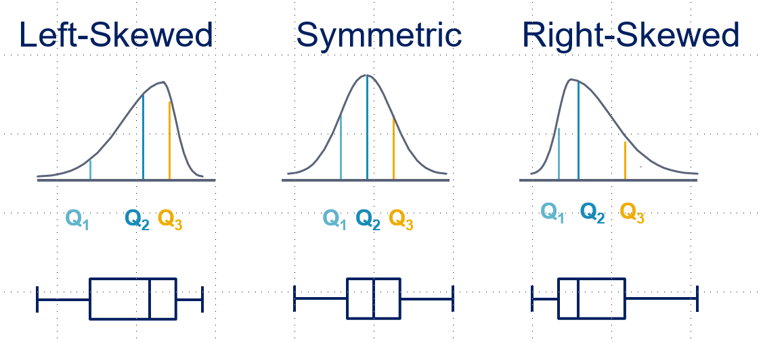
The Shape of a Boxplot Gives Insights into Data
If data are symmetric around the median then the box and central line are centered between the endpoints
Can inform whether or not data is skewed

Slide 30
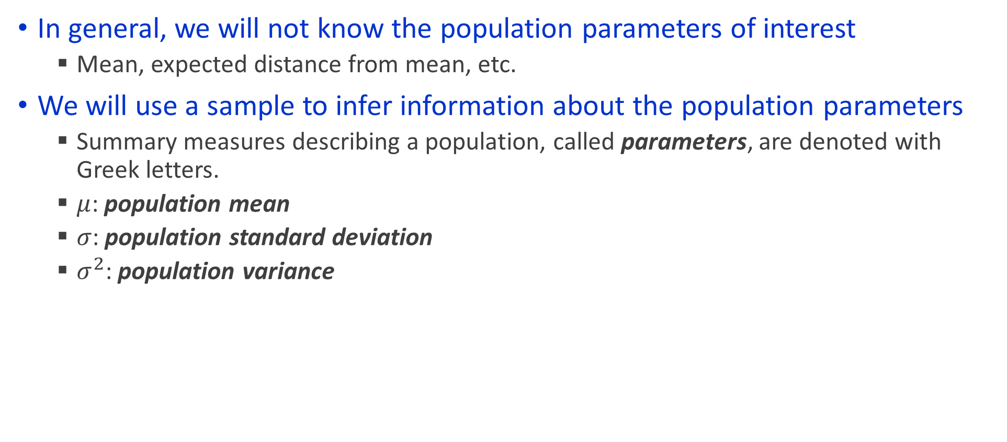
Measures of Central Tendency for a Population
In general, we will not know the population parameters of interest
Mean, expected distance from mean, etc.
We will use a sample to infer information about the population parameters
Summary measures describing a population, called parameters, are denoted with Greek letters.
$μ$: population mean
$σ$: population standard deviation
$σ^{2}$: population variance

Slide 31
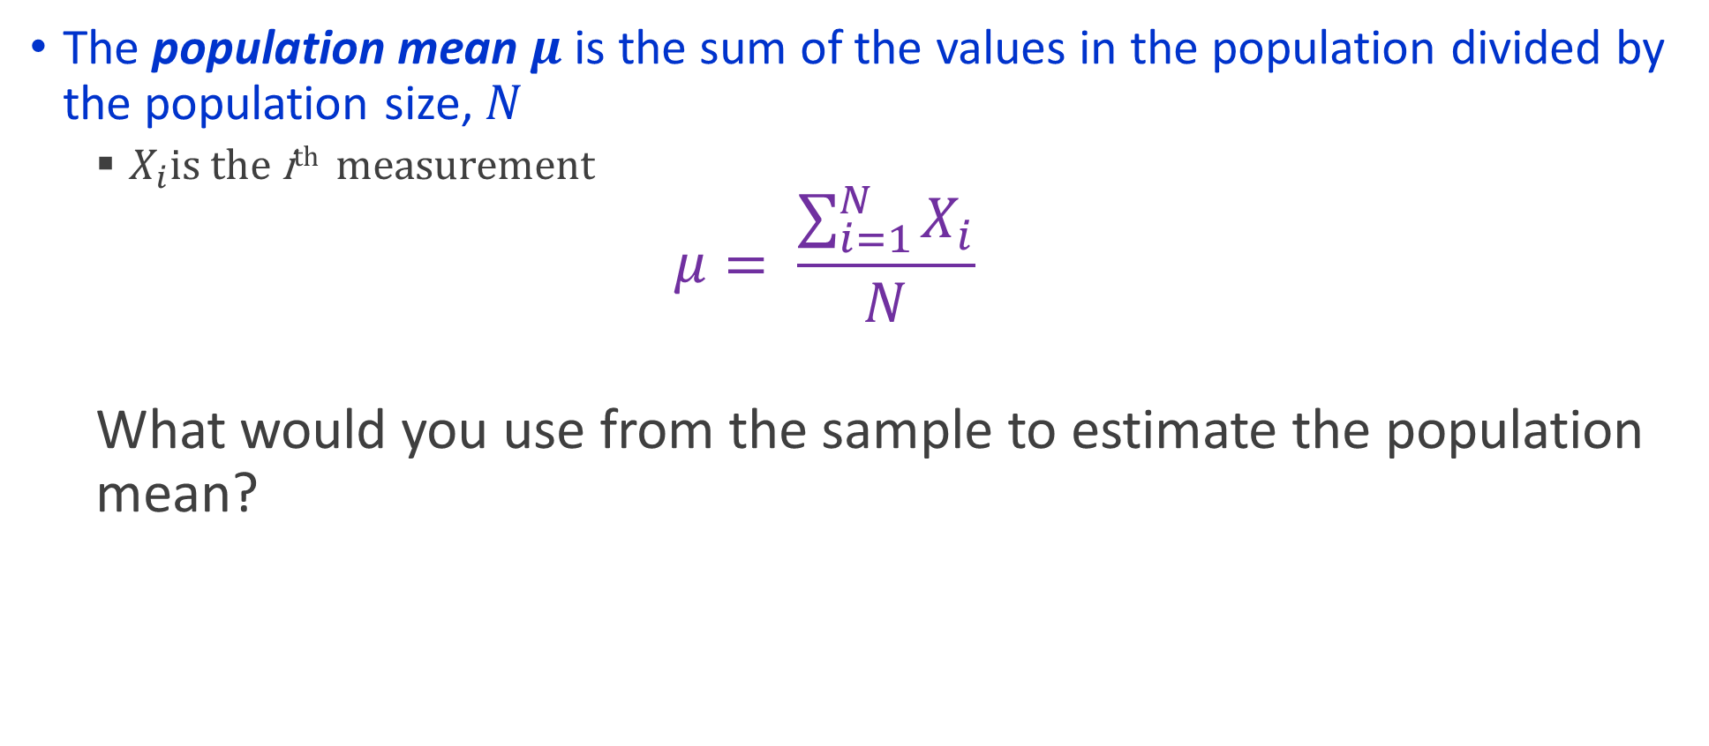
Population Mean
The population mean $μ$ is the sum of the values in the population divided by the population size, $N$
$X_{i}$is the i^{th} measurement
$$μ= \frac{\sum_{i=1}^{N}{X_{i}}}{N}$$
What would you use from the sample to estimate the population mean?

Slide 32
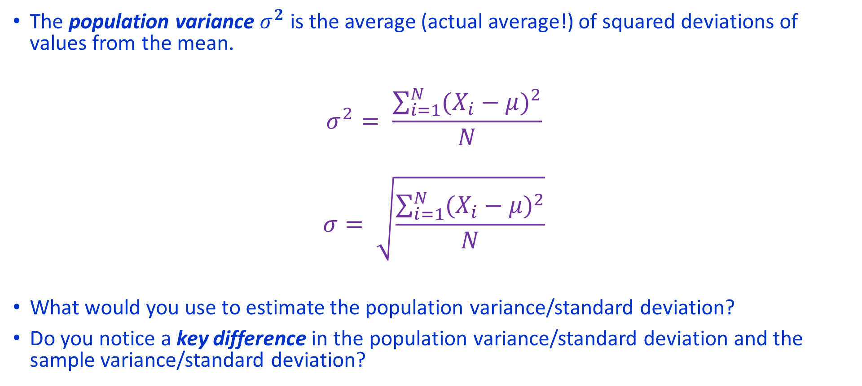
Population Variance
The population variance $σ^{2}$ is the average (actual average!) of squared deviations of values from the mean.
$$σ^{2}= \frac{\sum_{i=1}^{N}{{(X_{i}−μ)}^{2}}}{N}$$
$$σ= \sqrt{\frac{\sum_{i=1}^{N}{{(X_{i}−μ)}^{2}}}{N}}$$
What would you use to estimate the population variance/standard deviation?
Do you notice a key difference in the population variance/standard deviation and the sample variance/standard deviation?

Slide 33
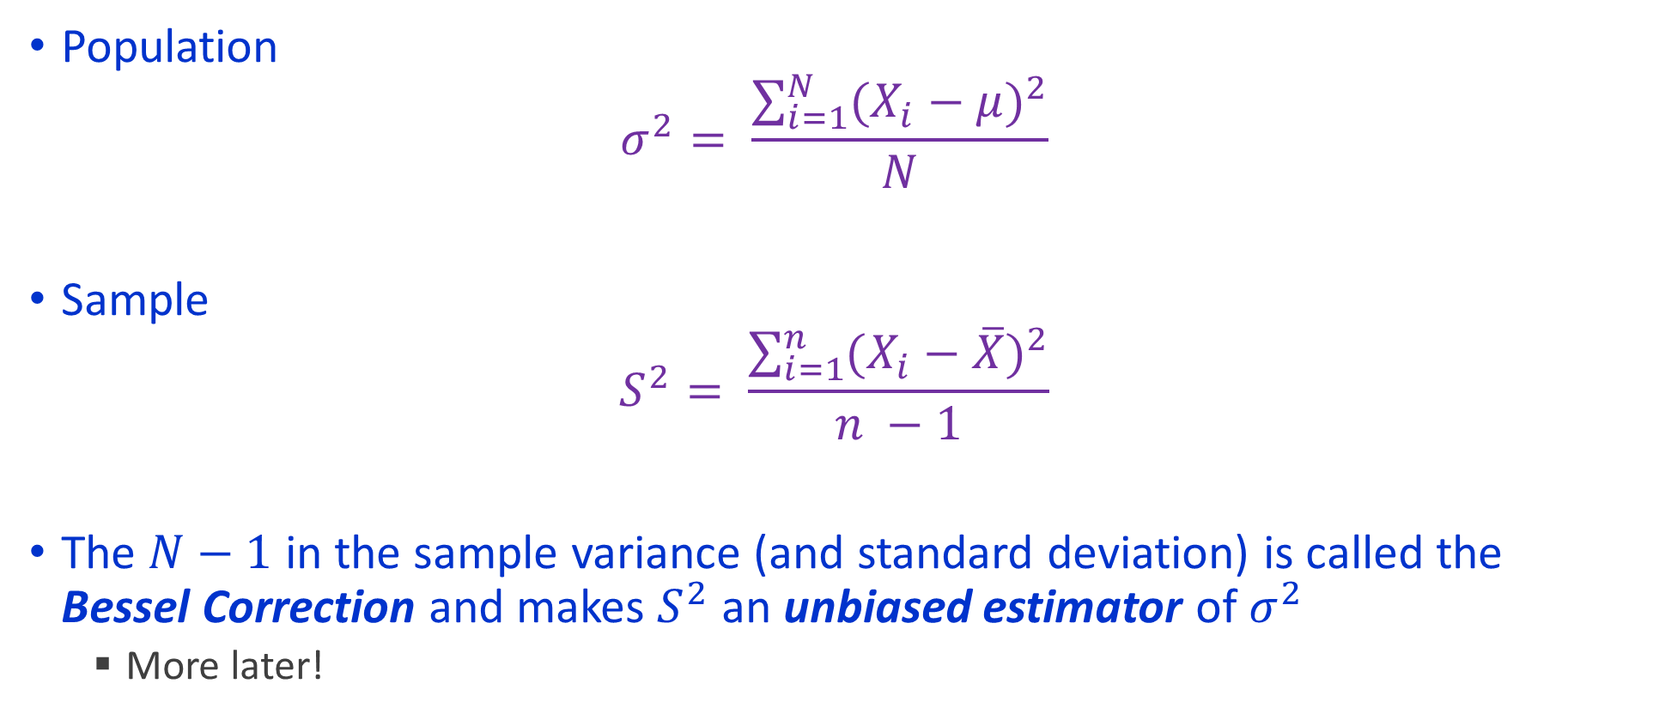
Population versus Sample Variance
Population
$$σ^{2}= \frac{\sum_{i=1}^{N}{{(X_{i}−μ)}^{2}}}{N}$$
Sample
$$S^{2}= \frac{\sum_{i=1}^{n}{{(X_{i}−\overline{X})}^{2}}}{n −1}$$
The $N−1$ in the sample variance (and standard deviation) is called the Bessel Correction and makes $S^{2}$ an unbiased estimator of $σ^{2}$
More later!

Slide 34
Data Visualization
A critical element of displaying data
We already saw a few examples in Boxplots
Enough material to fill an entire course
Exciting new technology (Tableau)
Different ways of displaying data can change the way we think
People devote their careers to the study of visualization
https://www.edwardtufte.com/tufte/index

Slide 35
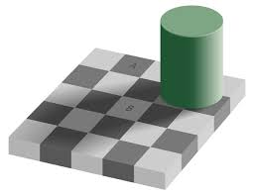
Visualization can be Tricky
Which square is darker?

Slide 36

Visualization can be Tricky

Slide 37
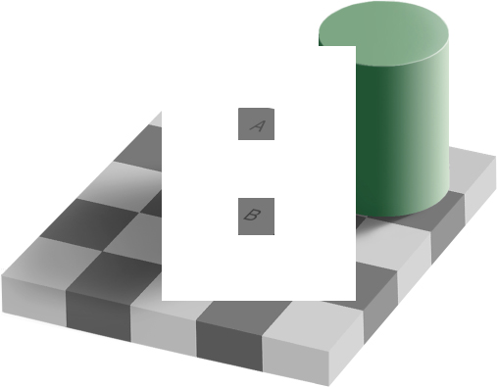
Visualization can be Tricky

Slide 38
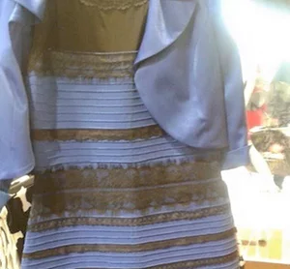
Visualization can be Tricky

Slide 39
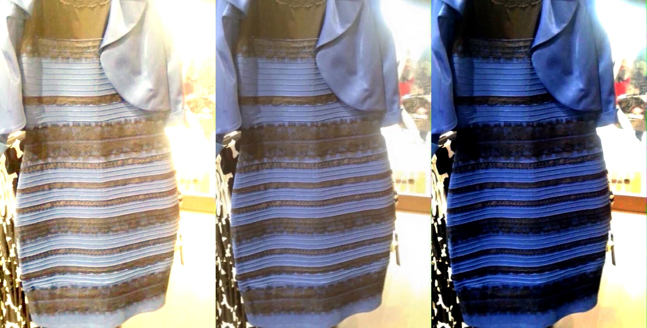
Visualization can be Tricky

Slide 40
Graphs are the main mechanism for displaying quantitative data
Boxplots
Scatter plots
Histograms
Pareto Charts

Slide 41
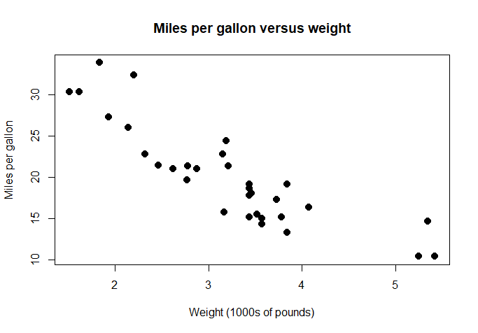
Scatter plot
Shows a 2D distribution of two variables, with a single dot per instance

Slide 42
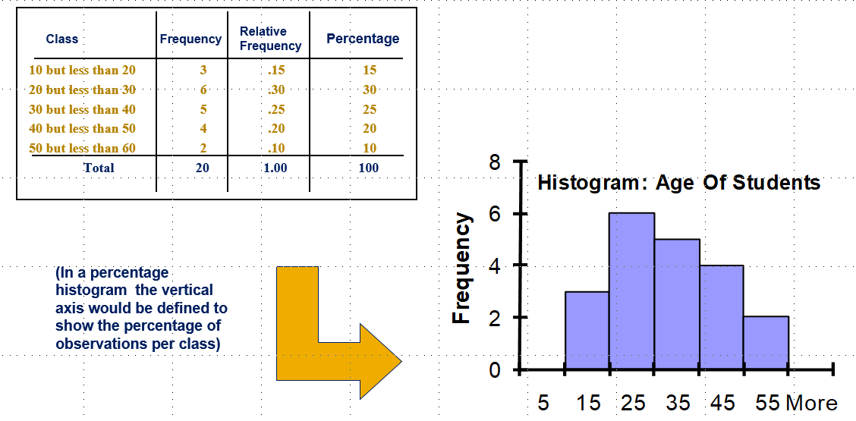
Histogram
A vertical bar chart of the data in a frequency distribution is called a histogram
In a histogram there are no gaps between adjacent bars
The class boundaries (or class midpoints) are shown on the horizontal axis
The vertical axis is either frequency, relative frequency, or percentage
The height of the bars represent the frequency, relative frequency, or percentage

Slide 43
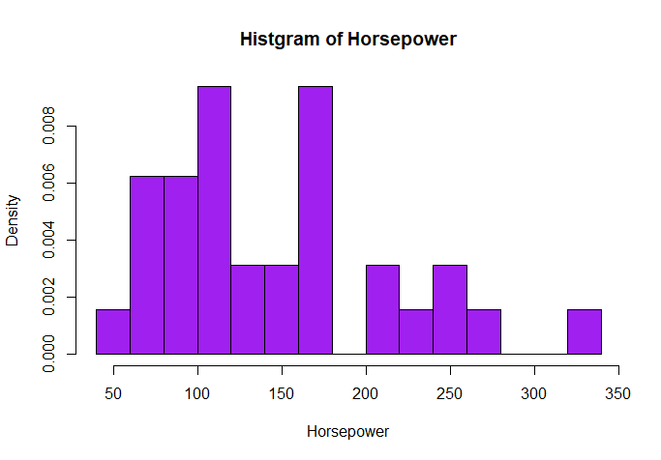
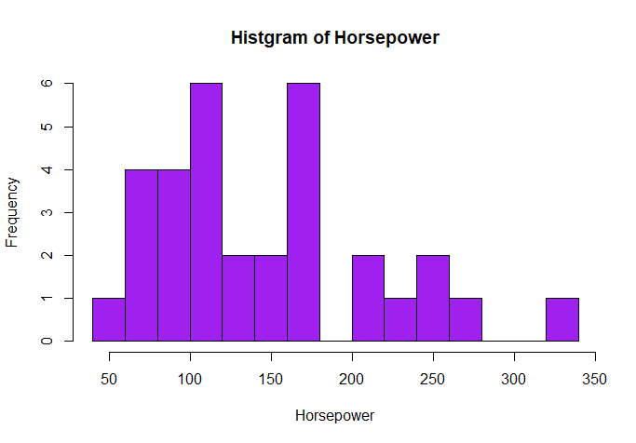
Can be absolute values or relative numbers
Can be frequency or density histogram

Slide 44
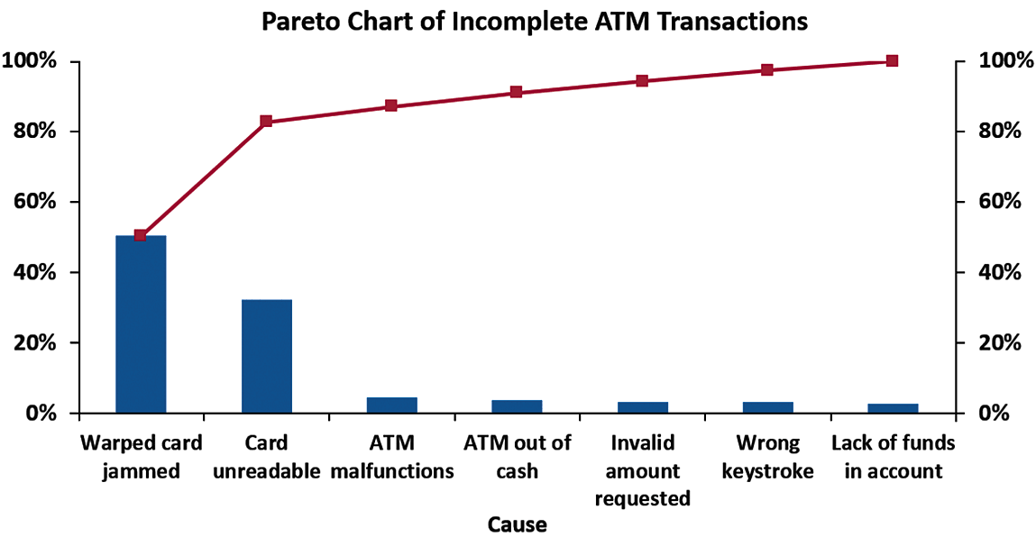
Pareto Chart
Used to portray categorical data (nominal scale).
A vertical bar chart, where categories are shown in descending order of frequency.
A cumulative polygon is shown in the same graph.
Used to separate the “vital few” from the “trivial many.”
The “Vital Few”

